Slide 1
Welcome to Class!
DRAW what comes to your mind when you hear the word: “DORSAL”

Slide 2
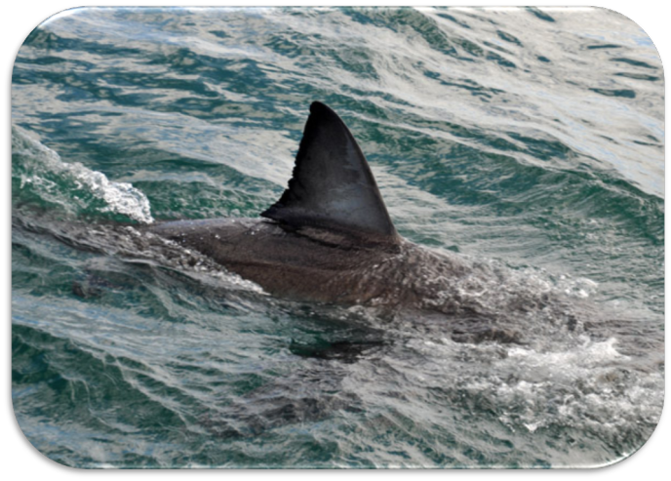
Did you draw a shark’s DORSAL fin?
What other things came to mind?

Slide 3
Identifying Directional Anatomical Terminology
Veterinary Medical Applications
TEKS 4B The student is expected to develop appropriate use of directional anatomical terms

Slide 4
Correct terminology must be used to describe “where” on an animal.
We will no longer use the following terms:
Back
Front
Below
Tail
Head
The middle
The end
The bottom of
…

Slide 5
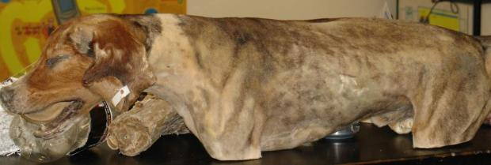
The 3 Anatomical Planes
Cuts are made through an animal’s body to view structures exposed by the cut.
While a very large number of possible cuts could be made, three right angle planes are the
most important =
Notes:
This model shown is a “plastinated” model of a deceased dog, preserved in such a way that it resembles plastic. These models are used at the Texas A&M University School of Veterinary Medicine to teach the veterinary students about the anatomy of different animals.

Slide 6
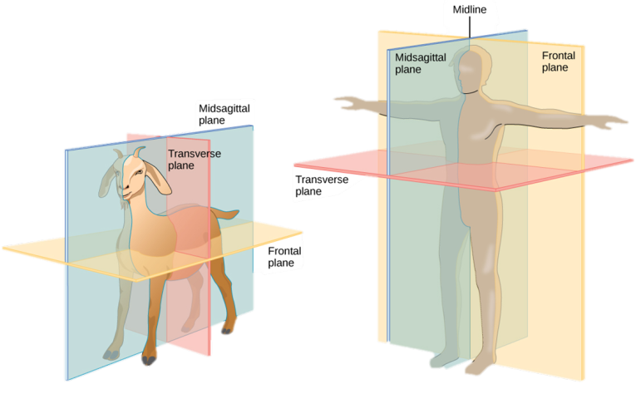
The 3 Anatomical Planes
These planes can be imaginary lines used to describe the symmetry or asymmetry of an animal’s body.
Coronal plane
Coronal plane

Slide 7
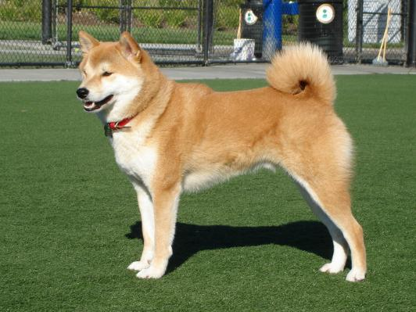
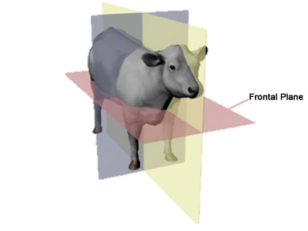
1. Coronal or Frontal Plane
Plane that divides the body into anterior and posterior (front and back).
Back
Front
Notes:
Note: The coronal plane can be tricky when comparing animals and people, since animals typically are on all fours their “front” is not the same as human’s front and back.

Slide 8
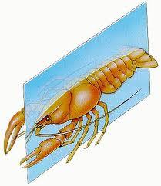
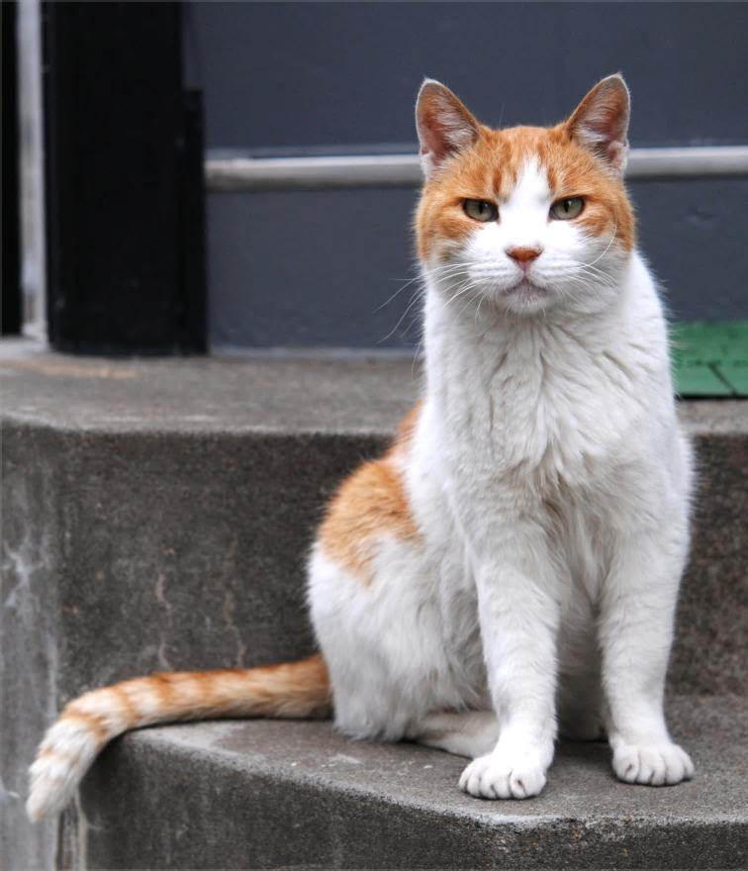
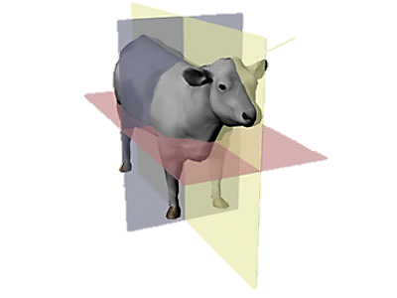
2. Sagittal Plane
Plane that runs down through the body, dividing the body into left and right.
Sagittal Plane
Right
Left
Notes:
Note: Right and left are the subject’s right and left, so even though when we are looking at the cat our left side is not his left side – it is the cat’s right side. Remind students to keep this in mind.

Slide 9
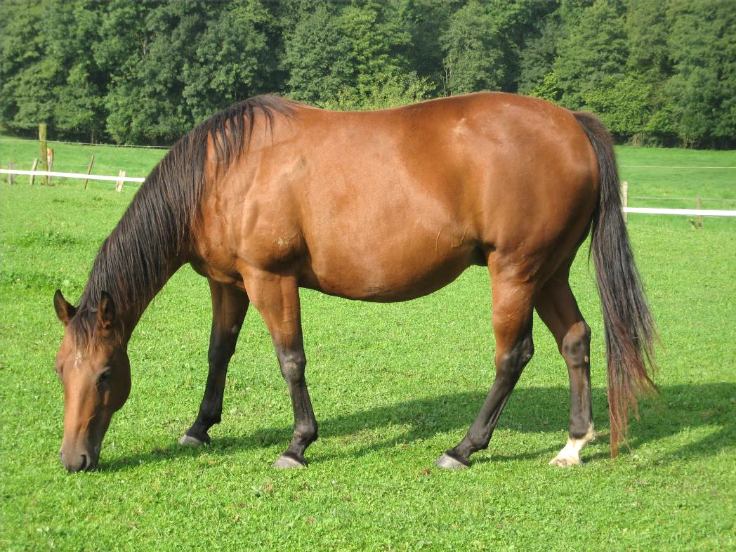
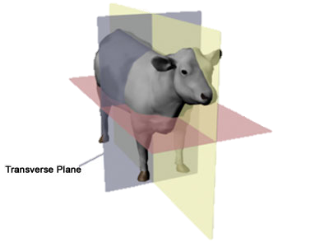
3. Transverse Plane
Plane that divides the body into cranial and caudal (head and tail).
Head
Tail

Slide 10
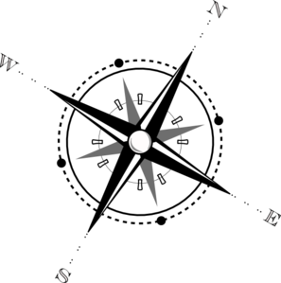
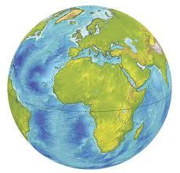
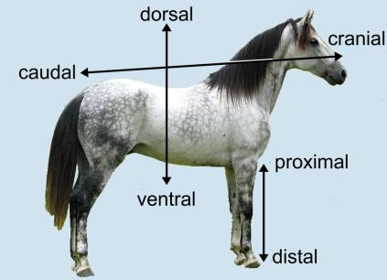
Anatomical Descriptive Terms
Descriptive words are used to describe “where” on an animal.
Like using North, South, East, or West for locations on a map.

Slide 11
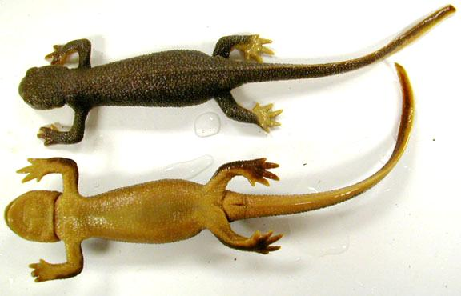
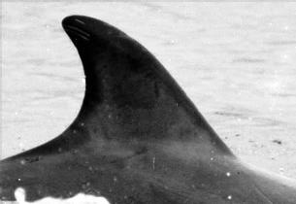
Dorsal/Ventral:
Dorsal -- toward the back Ventral -- toward the front/belly
Separated by the frontal plane
Ventral
Dolphin’s Dorsal fin
Dorsal
Ventral
V
entral
Notes:
The V in ventral can look like an arrow pointing downward to the underside or belly of an animal. Students can also remember dorsal by thinking of a Dolphin’s Dorsal fin on its back!
Animation on this slide.

Slide 12
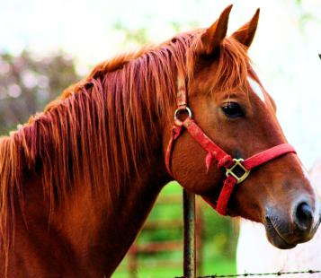
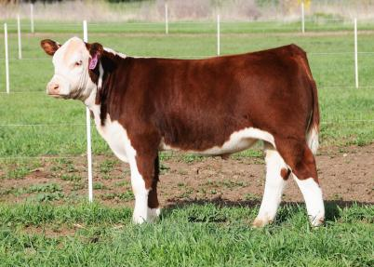
Cranial/Rostral/Caudal:
Cranial -- toward the head
Rostral -- toward the nose/beak
Caudal -- toward the tail
Separated by the transverse plane
Rostral
Cranial
Caudal
Cranial
Rostral

Slide 13
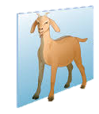
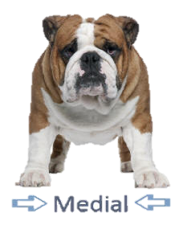
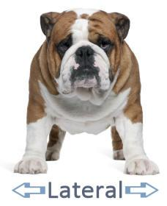
Medial/Lateral:
Medial – directed toward the midline (sagittal plane)
Lateral -- directed away from the midline (sagittal plane)
Sagittal Plane

Slide 14
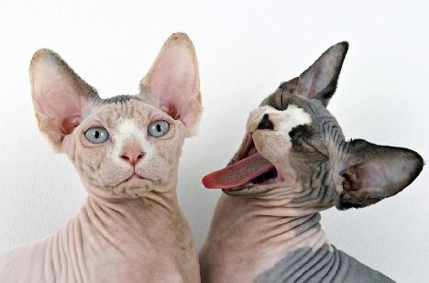
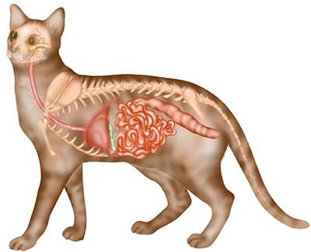
Superficial/Deep
Superficial –- located near the surface
Deep –- located internally, toward the center
Deep: The Digestive system is deep.
Superficial: The integumentary system (skin) is superficial

Slide 15
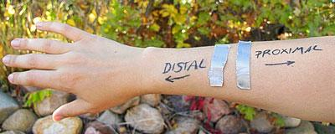
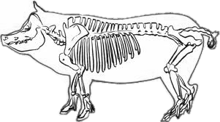
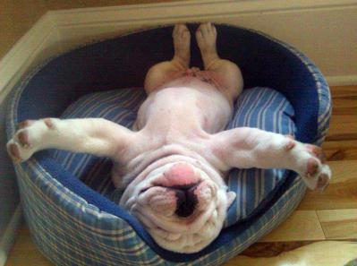
Proximal/Distal:
Proximal -- located close to the sagittal line of the body.
Distal -- located away from the sagittal line of the body
Proximal
Distal
Notes:
Good words for students to relate to for memory:
Proximal- proximity
Distal- distance
The pictures show an example of how an animal’s elbows (or knees) are proximal while the feet are distal.

Slide 16
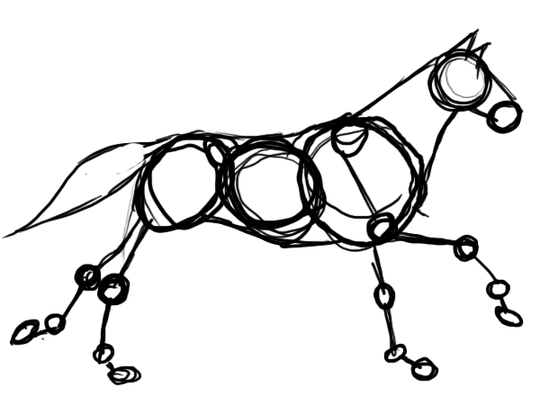
Anatomical Actions
Descriptions of moving joints.
One set of muscles moves a joint in one direction; another set of muscles moves the same joint in the opposite direction.

Slide 17
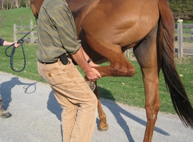
Extension/Flexion:
Extension -- increase the angle formed by a hinge joint.
Flexion -- decrease the angle formed by a hinge joint.
Flexion
Extension

Slide 18
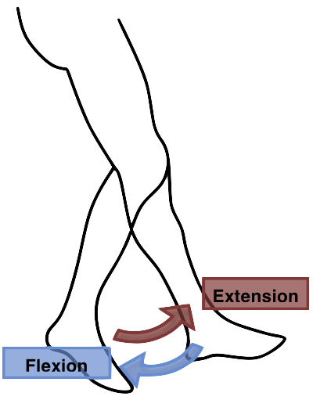
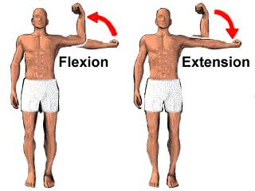
Relate to Humans: Extension and Flexion

Slide 19
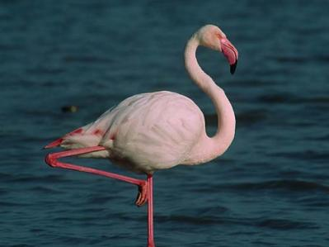
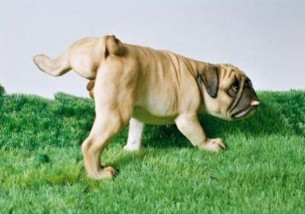
Abduction/Adduction:
Abduction -- move the limb away from the body.
Adduction -- move the limb toward the body.
Adduction
Abduction
Notes:
An example of humans showing abduction or adduction would be to move the arms away from the body or toward.
The pictures above would switch definitions when they put their legs back to standing position. The flamingo would let the leg down, away from the body (abduction) and the dog would bring the leg back, toward the body (adduction).

Slide 20
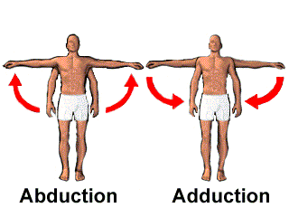
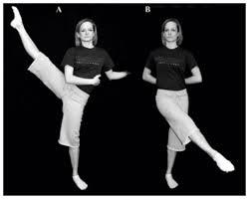
Relate to Humans: Abduction and Adduction
Adduct
Abduct

Slide 21
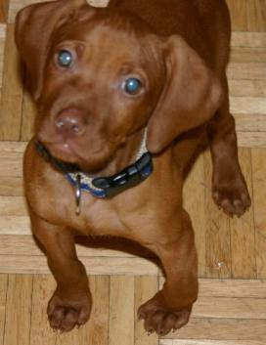
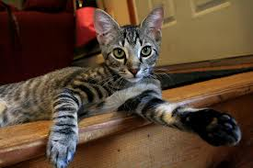
Supination/Pronation:
Supination -- rotate the limb outward, laterally.
Pronation -- rotate the limb inward, medially.
Supination
Pronation

Slide 22
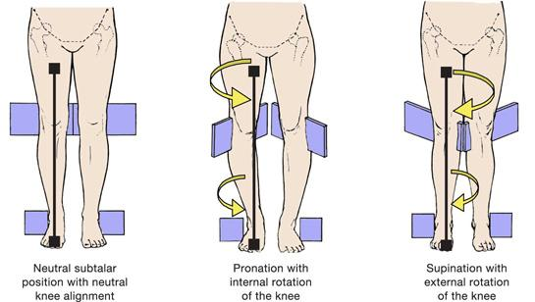
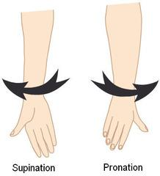
Relate to Humans: Supination and Pronation

Slide 23
LET’S REVIEW
Anatomical Terminology

Slide 24
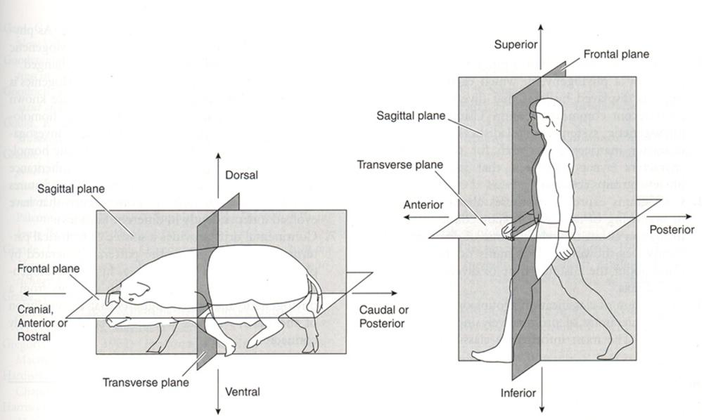

Slide 25
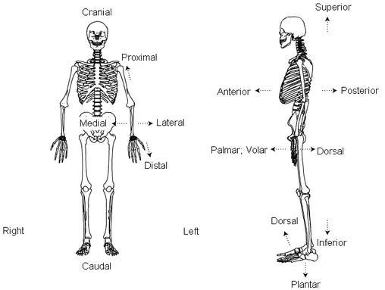

Slide 26
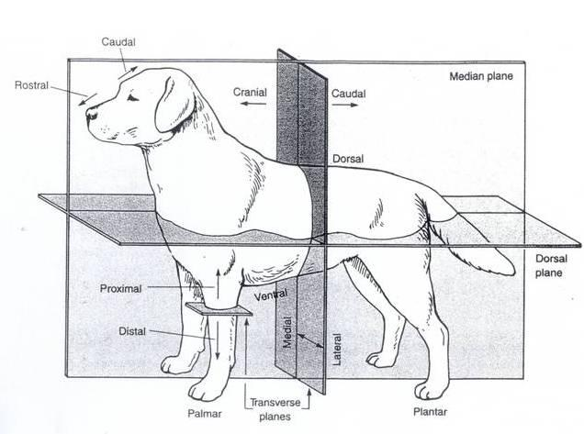

Slide 27
TASK 1:
Gummy Bear Dissection Lab Activity
Using the norms for groups work you and your partner will dissect gummy bears in the order presented on the lab sheet.
Mrs. Weimer MUST see your work before you can eat any of your bears.
Try to remember the names and vocabulary associated with these, as they are on the quiz at the end of this unit.

Slide 28
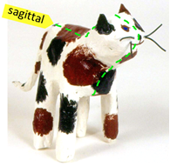
TASK 2:
Anatomical Direction Application Activity
Using the norms for groups work you and your lab group (up to 4) will CREATE a paper mache model of an animal and then LABEL all the parts on the directional terminology page.
These will be displayed, so you will need to do your BEST work.
They are also graded on how well you PRESENT
your model to the group and then RELATE
the functions and terms to humans, so this is
both a CREATE and EVALUATE grade.

