Slide 1
Aquatics Article Summaries

Slide 2
A Fish & Livestock Tail
Poor agricultural practices, especially in pastureland
Cause wash out of habitat (trees, logs, debris)
Widens and shallows stream (sometimes fish dorsal fins break water surface)
Increases silt, temperatures
Decreases water speed
Insects and fish cannot reproduce
Nutrients, pesticides, bacteria all increase

Slide 3
A Fish & Livestock Tail
Increased risk of disease and injury to cattle
Recreational activities decline, affecting economics
Increased flooding and property damage
Loss of cold-water trout streams to warm-water classification

Slide 4
A Fish & Livestock Tail
Don’t allow livestock in water
Create crossing bridges, use fencing
Use cattle slats- rectangular, precast concrete slabs used to make ramps
Use off stream watering systems for cattle
Stabilize banks by using streamside fencing
Dramatically reduce sediment
Birds prefer riparian areas
As little as 20 feet can benefit greatly
DEP, US Fish & Wildlife Service, Chesapeake Bay Foundation, Ducks Unlimited will do free fencing
Manage whole area as one ecosystem

Slide 5
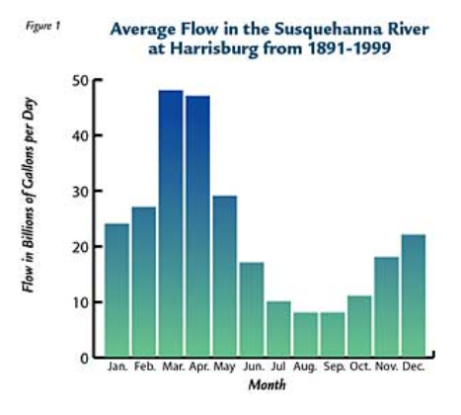
Fish Habitat and Flow
Habitat- place or type of site where animal is naturally found
Fish need varying amounts of water
Natural Flow Regime- how flow changes on a stream over time
Susquehanna River range 1.1bgd to 616.3bgd

Slide 6
Fish Habitat and Flow
Floods and droughts aren’t inherently bad- fish need a variety
Floods-
Transport “bed load” (silt, sand, boulders on stream bottom)
Shape and composition of stream bottom affect habitat
Dynamic equilibrium- always changing on a small scale, but remaining consistent on a large scale
Droughts-
Favors smaller species, allows balance with larger predators
Creates more diverse fish population
Smallmouth bass benefit from low water during spawning

Slide 7
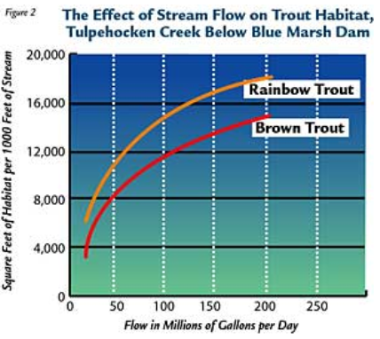
Fish Habitat and Flow
Instream Flow Incremental Methodology (IFIM) is used to determine how much water fish need
Uses computer models to calculate relationships
Hydraulic- depth, velocity, cover, substrate
Biological- cover types, life stage
Habitat- combined hydraulic and biological
Water quality – how temperature, pH, DO, etc. change with flow

Slide 8
Fish Habitat and Flow
PA Regulations for water withdrawals come from DEP, Susquehanna River Basin Commission, and Delaware River Basin Commission
Fish & Boat Commission consults with these organizations and others including Federal Energy Regulatory Commission (FERC)
Researching effect of groundwater removal from wells on streams

Slide 9
Migratory Fish Regulation
Problems affecting shad are 200 years old
PA Anadromous fish- shad, herring, striped bass, Atlantic Sturgeon
Spawn in different sections
All migrate to ocean, spend several years migrating up and down Atlantic coast, return back to river of birth
Prior to 1700s- subsistence anglers
After 1700s- commercial fishing
1800s- “clear cutting” of fish before reproduction caused collapse

Slide 10
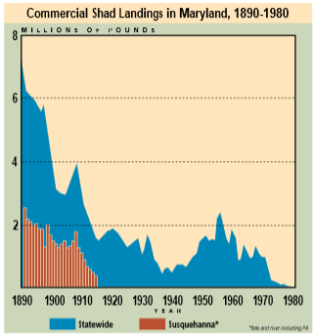
Migratory Fish Regulation
1890 over fishing caused dramatic drop off

Slide 11
Migratory Fish Regulation
Construction dams also a major factor
Especially large hydroelectric dams from 1904-1932
Pollution increase due to population increase
Formed impenetrable slug on Delaware River
Restoration efforts
Formation of Fish & Boat Commission in 1866
Early efforts- fishing regulations, stocking, passage
Early ladders were improperly designed, leading to them not being required on new dams

Slide 12
Migratory Fish Regulation
Delaware River Run
1970s water quality laws removed pollution slug
Revival of Shad
Western dams had proper fish ladders
Required installation of fish lifts by 1972
Fishways now constructed on all dams
Stock fry above dams
Striper Decline
Declined much later than others due to fishing
Regulation, stocking, research
Requires interstate and federal management

Slide 13
Migratory Fish Regulation
Why Restore Fish
Food
Predators
Top of food chain
Economics

Slide 14
On the Road to Extinction
Natural extinction happens slowly
Current rate is 1000s of times faster
Many of the top drugs originate in nature
500 species extinct in America since 1620s
Endangered Species Act of 1973 provides protection
PA Fish & Boat Commission has control over amphibians and reptiles

Slide 15
On the Road to Extinction
Endangered- immediate danger of extinction
Threatened- may become endangered if not protected
Candidate- species that could become endangered or threatened
Extirpated- Extinct only in PA, or part of natural range
Habitat loss is main issue for endangerment
PA lost over ½ of wetlands causing loss of amphibians and reptiles

Slide 16
On the Road to Extinction
Highway construction- death during breeding
Acid precipitation, UV, pesticides, and other chemicals also contribute
What’s Being Done
Lots of research
Permits
Education
What You Can Do
Learn endangered animals in your area
Become involved and get educated

Slide 17
PA’s Threatened & Endangered Fishes
Difficult to get support because they’re not cuddly, cute mammals
Most endangered species are fish
Due to habitat loss, alteration, pollution, overfishing, disease, predation, competition with invasives
Fish often have specific needs or unique life cycle requirements

Slide 18
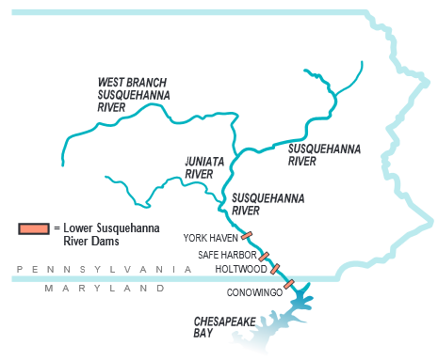
PA’s Threatened & Endangered Fishes
Obstacles to migration
Dams
Deadly water
Most endangered fish in western PA due to city industries and reversal of French Creek due to glacier activity
Taking too many

Slide 19
PA’s Threatened & Endangered Fishes
Helping Hand
Develop list
Study
Set rules and regulations
Permits
Rerouting of Marshalls Creek Bypass in Monroe County due to 2 minnows (ironcolor shiner only here)

Slide 20
Timbering & Trout
Past forestry caused loss of fish resources, now that timbering is increasing it needs to be avoided
Pennsylvania Clean Streams Law
Timbering involves cutting, hauling, road building, etc.
PA is world’s top supplier of black cherry
Silt pollution is acute not chronic, invertes die which are a trout food source

Slide 21
Timbering & Trout
Conservation Districts require site plans with stream crossings, wetland avoidance, etc.
Use hay bales, water bars (soil piles that direct water flow onto vegetated areas)
Encourages but does not require re-establishing vegetation
Plan must be on site and followed, fines and prison are options
Most issues with small operations
Education has improved, so have practices
Loggers take classes toward a master logger certificate
Laws apply to public, not private land

Slide 22
Wetlands: The Vital Link
Reduce flooding, reduce sedimentation, provide food
Previously viewed as hindrance and destroyed
Often transition ands between waterways and upland areas
Vernal ponds- temporary wetlands
Many types- swamps, estuaries, marsh, mangrove, deltas, lagoons, springs, bogs, moors, muskegs, potholes, fens, mires

Slide 23
Wetlands: The Vital Link
Must support hydrophytic plants - have adaptations to survive with limited oxygen
Must have hydric soils- do not drain well and have anaerobic conditions
Presence of hydrological regime- water at some point during the year

Slide 24
Wetlands: The Vital Link
Wetlands can remove 95% of silt form water column just by slowing it
Plants remove nutrients to prevent eutrophication (over fertilization of aquatic systems)
Increased land use has spiked eutrophication
Animals live in wetland or return there to breed (Jefferson salamanders)

Slide 25
Wetlands: The Vital Link
221 Million acres of wetland before Europeans arrived, now less than half
Loss of 290,000 acres per year
Purple loosestrife creates monotypic stands
Dam Safety and Encroachments Act and Federal Clean Water Act protect wetlands
Avoid, minimize, compensate

