Slide 1
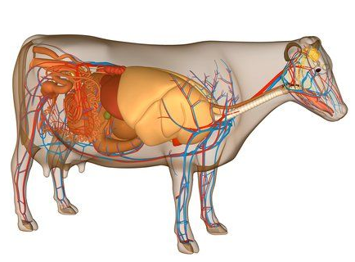
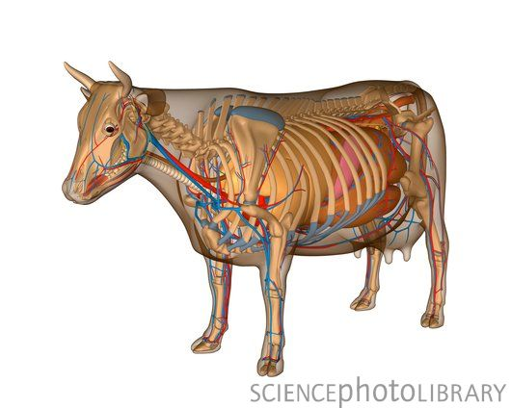
Animal Physiology
Source sciencephoto.com

Slide 2
Organization in Living Organisms.
A key concern in living organisms is maintaining homeostasis.
Homeostasis is the term for when an organism maintains constant internal conditions in regards to temperature, pH, salinity, etc.
Bodily substances in animals are categorized in a few levels.
The most basic unit of life is the cell.
A group of similar cells that perform the same function is called tissue.
A group of different kinds of tissues that coordinate their actions into a main primary function is called an organ.
A group of organs and tissues that work together to maintain homeostasis in the body are called a system.
There are 11 major systems in the body.

Slide 3
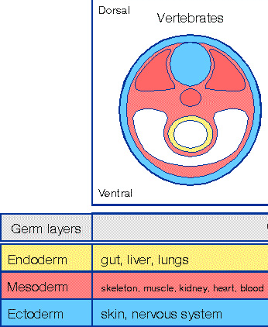
Levels of Organization
When an egg cell is fertilized by a sperm cell, there is no differentiation of the cells – at first, all of the cells are identical to each other.
However, as cells divide, three distinct layers of cells begin to form.
These layers include…
Ectoderm – skin and nervous system
Mesoderm –muscular system, connective tissue, and skeleton, kidneys, cardiovascular system, and reproductive organs,
Endoderm – digestive tract, respiratory system, and bladder.
Source: mun.ca

Slide 4
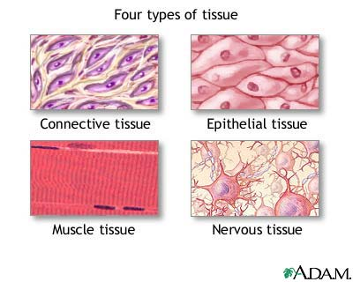
Specialization
The development of the three layers in cells is beneficial – it enables cells to form groups that specialize in specific functions.
It would never work to have every cell try to perform every function – there are simply too many functions and too much complexity in an animal’s body.
Having cells specialize and differentiate into specific tissue enables the body to become more complex than simpler organisms.
As cells specialize and differentiate, they will turn into one of 4 kinds of tissue – epithelial, connective, muscular, and nervous tissue.
Source: nlm.nih.gov

Slide 5
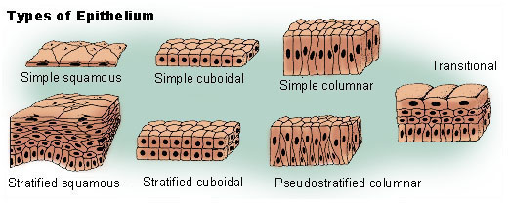
Epithelial Tissue
Epithelial Tissue forms the skin and the lining of the organs in most animals.
Epithelial tissue serves several functions:
Protection – surface epithelial tissue (such as the skin) keeps the ‘bad stuff’ out and the ‘good stuff’ in.
Some epithelial tissue like the respiratory tract is also lined with cilia (microscopic hairs) that can move impurities away from the tissue.
Absorption – the gut is lined with epithelial tissue in order to acquire nutrients from food.
Secretion – glandular epithelium is what is responsible for the release of substances such as hormones, saliva, milk, etc.
Source: training.seer.cancer.gov

Slide 6
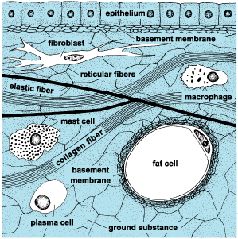
Connective Tissue
Connective tissue serves several functions, including –
Structural – it can hold body parts together
It can fill empty spaces in the body.
Energy – adipose tissue stores fat
Protection: it protects susceptible body parts,
Transport: Connective tissue can transport materials throughout the body.
Examples of connective tissue include bone, fat (adipose), cartilage, and blood.
Source; answers.com

Slide 7
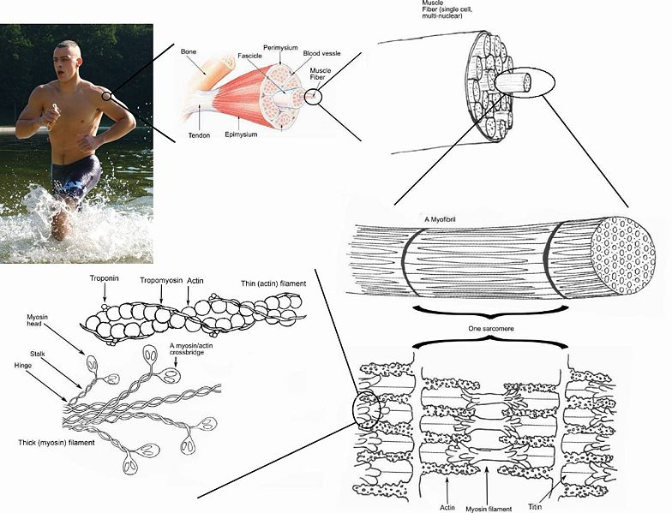
Muscle Tissue
Muscle tissue is the only kind of tissue that can contract, or change in size.
This is due to the fact that muscle tissue contains actin and myosin proteins that overlap and can ‘pull’ into each other.
There are three kinds of muscle tissue:
1. Smooth – smooth muscle is involuntary and is primarily found in the intestines and blood vessels.
2. Skeletal– skeletal muscle is voluntary (usually) and long (skeletal muscle cells are the length of the entire muscle).
3. Cardiac – cardiac muscle is found in the heart; it is involuntary.
Source en.wikipedia.org

Slide 8
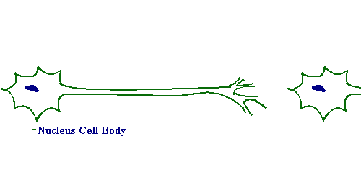
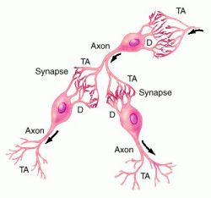
Nervous Tissue
Source: peer.tamu.edu
Nervous tissue can create electrical signals using sodium and potassium in order to signal the rest of the body.
Changing sodium/potassium levels create changes in the electrical charge of the cell.
Biochemicals called neurotransmitters will send signals from nerve cell to nerve cell.
Nervous system tissue includes the brain, spinal chord, and peripheral nerves in the skin and other organs.
Source: medical-dictionary.thefreedictionary.com

Slide 9
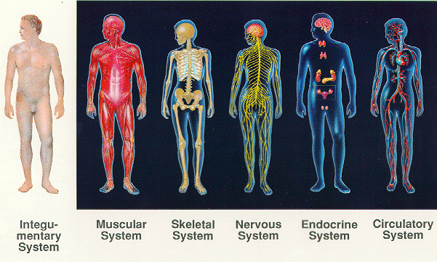
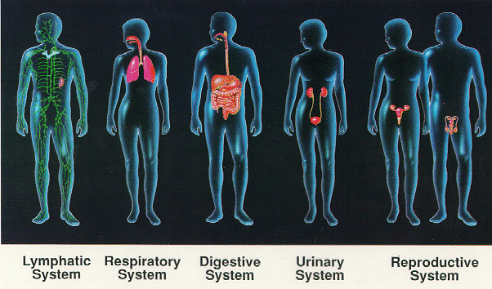
Organs & Organ Systems
Organs are made up of the four kinds of tissue.
This tissue will form an organized structure such as a sheet, tube, strip, layer, etc.
Organs together will form Systems, or a collection of organs that serve a specific function.
Source: aarcaro.wordpress.com

Slide 10
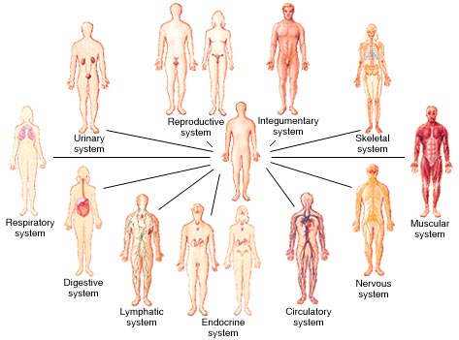
The 10 Systems of the Body
There are 10 organ systems in the animal body.
These include the 1) circulatory, 2) respiratory, 3) digestive, 4) urinary, 5) musculoskeletal, 6) immune, 7) nervous, 8) endocrine, 9) reproductive, and 10) integumentary system.
Note: in some cases, the musculoskeletal system could be considered two separate systems, for a total of 11.
Source: healthadviceonline.biz

Slide 11
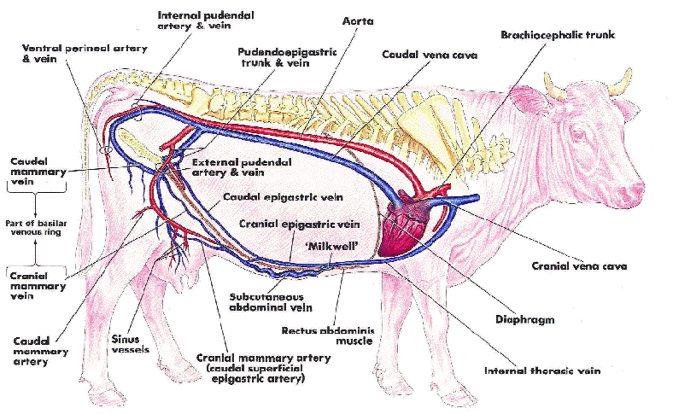
Circulatory System
The purpose of the circulatory system is to transport blood, hormones, nutrients, and waste throughout the body.
It consists of the heart, arteries, veins, capillaries, and the blood.
It carries nutrients to the cells and waste away from the cells.
Source: ucd.ie

Slide 12
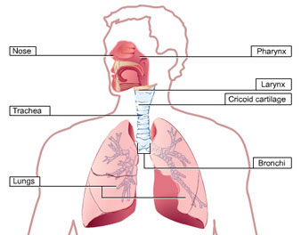
Respiratory System
The function of the respiratory system is to add oxygen to the body and take away carbon dioxide.
Oxygen is needed for cellular respiration – it carries away waste products from the process of producing ATP (the source of energy for the cells)
Carbon dioxide is a waste product from cellular respiration.
The respiratory system also helps to regular the concentration of hydrogen ions in the blood.
This system includes the lungs, bronchi, larynx, pharynx, and nose.
Source: alpha1health.com

Slide 13
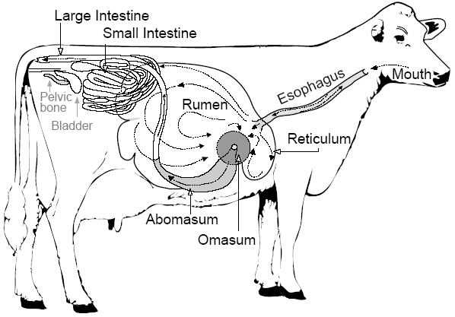
Digestive Tract
The purpose of the digestive tract is to absorb organic nutrients (carbohydrates, fats, protein), salts, and water from food and expel unused waste products from the body after nutrient absorption.
This system consists of the mouth, pharynx, esophagus, stomach chambers, small and large intestines, salivary glands, pancreas, liver, and gallbladder.
Source: phs.d211.org

Slide 14
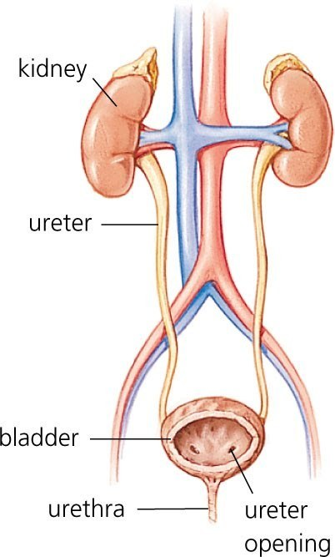
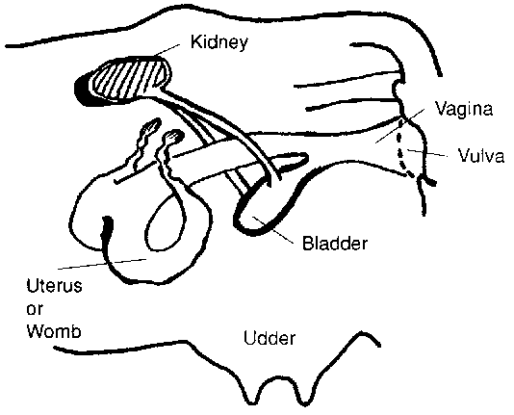
Urinary System
The urinary system ensures that the osmolarity (salinity level) of bodily fluid is maintained through the controlled excretion of salt, water, and waste.
If the body’s fluids are too dilute, it would cause edema (fluid build-up), low plasma volume, hypotension (low blood pressure), and could cause heart/lung failure (sodium and potassium are needed for nerve transmission).
If the body’s fluids are too concentrated, it would cause dangerously high pressures in the blood and other fluids.
This system includes the kidneys ureters, bladder, and urethra.
Source: scoop.it
Source: fao.org

Slide 15
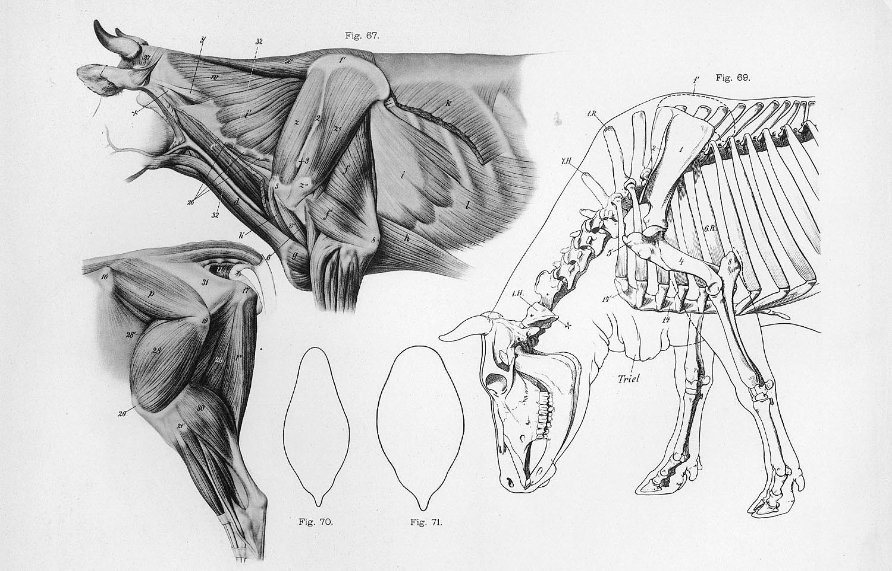
Musculoskeletal System
The function of this system is to support, protect, and enable movement of the body.
The bone marrow also serves as the site of blood cell production.
The muscles are able to enable movement because of high concentrations of actin and myosin contractile proteins that can allow the muscle cells to shorten or lengthen.
This system includes the bones cartilage, skeletal muscles, ligaments, tendons, and joints.
Source: characterdesignnotes.blogspot.com

Slide 16
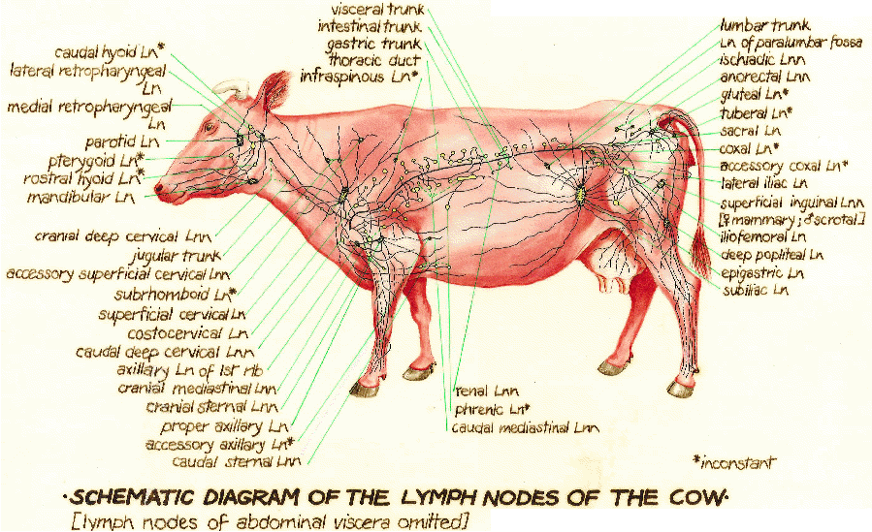
Immune System
The primary purpose of the immune system is to recognize the difference between the cells of the host animal and invading cells and pathogens.
The immune system defends against attacking pathogens, returns extracellular fluid to the blood, and enables the formation of white blood cells.
This system includes the white blood cells, lymph nodes, spleen, and thymus.
Source: http://www.ucd.ie/vetanat/images/101.gif

Slide 17
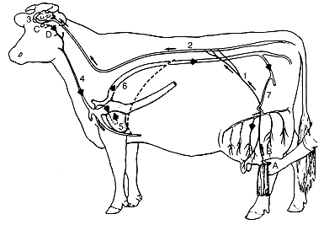
Nervous System
The purpose of the nervous system is to coordinate the activities of the body through the transmission of electrical signals.
The nervous system also detects changes inside and outside of the body and enables conscious decision-making and action.
The nervous system includes the brain, spinal cord, nerves, and sensory organs such as the eyes, tongue, etc.
Source: nongae.gsnu.ac.kr

Slide 18
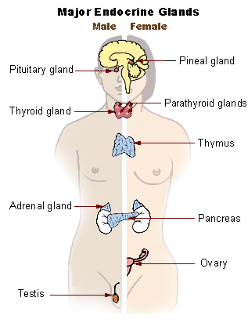
Endocrine System
The endocrine system regulates and coordinates many different bodily processes, including blood pressure, electrolyte levels, metabolism, growth, etc.
Typically these are long processes as opposed to quick changes.
This system includes all glands that secrete hormones, including the pancreas, hypothalamus, pituitary gland, thyroid gland, intestines, testes/ovaries, etc.
Source: recoveringwitht3.com

Slide 19
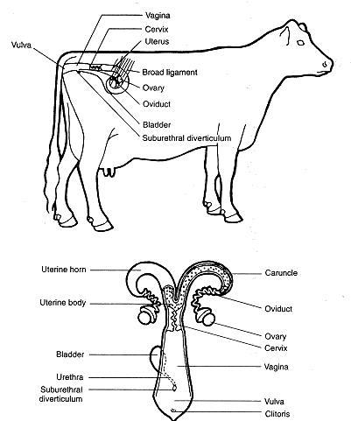
Reproductive System
The reproductive system produces haploid sex cells (sperm/egg), enables conception, and supports a fertilized egg until the fetus is mature.
This system includes testes and penis in males and vulva, vagina, cervix, uterus, and ovaries in females.
Source: nongae.gsnu.ac.kr

Slide 20
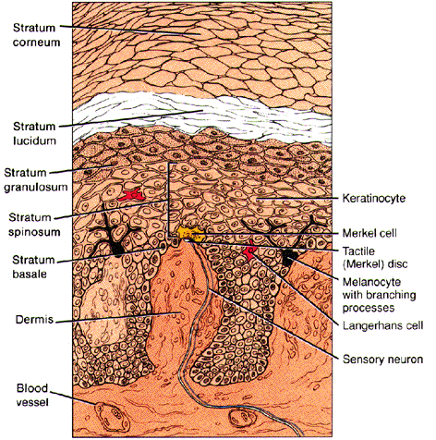
Integumentary System
The integumentary system protects against injury, dehydration, and invading pathogens.
It also aids in the regulation of body temperature.
This system includes skin, hair, and nails.
Source: premonvandam.webs.com

