Slide 1
HISTORY OF TECHNOLOGY
Foundations of Technology 9th Grade
J Kush 9-2010 Revised 11-11-10

Slide 2
WHAT IS IT?????
22 inventors tried and failed before

Slide 3
WHAT IS IT?????
22 inventors tried and failed before
the date was October 22, 1879

Slide 4
WHAT IS IT?????
22 inventors tried and failed before
the date was October 22, 1879
a vacuum exists on the inside

Slide 5
WHAT IS IT?????
22 inventors tried and failed before
the date was October 22, 1879
a vacuum exists on the inside
has an incandescent outer material

Slide 6
WHAT IS IT?????
22 inventors tried and failed before
the date was October 22, 1879
a vacuum exists on the inside
has an incandescent outer material
uses a carbon filament

Slide 7
THE LIGHT BULB (aka the incandescent lamp)

Slide 8
Think about…
How did the light bulb influence the lives of the people who first used it?

Slide 9
Think about…
How did the light bulb impact the way people lived?
3.5 The approximate loss in hours of American’s nightly
sleep since the invention of the lightbulb.
(According to Popular Science Magazine)

Slide 10
Think about…
How did the light bulb impact the way people worked?

Slide 11
Think about…
How did the light bulb impact the way people produced things?

Slide 12
Think about…
How did the light bulb influence or change history forever?

Slide 13
Think about…
How did the light bulb influence or change history forever?
ANSWER:
It was a “TURNING POINT”!

Slide 14
Group Work Time…
GROUPS OF TWO
TOPICS:
Plow Internal combustion engine
Irrigation System Rubber tires
Cannon Air conditioning
Printing Press Locomotives
Steam Engine
Radar
Computer
Satellites
Fertilizer
Space Shuttle

Slide 15
TOPICS: Plow, Irrigation System, Cannon, Printing Press, Steam Engine, Radar, Computer, Satellites, Fertilizer, Space Shuttle
ANSWER THESE QUESTIONS
& PRESENT THE INFORMATION
*List 6 or more examples for each.*
How did it influence the lives of the people who first used it?
How did it impact the way people lived?
How did it impact the way people worked?
How did it impact the way people produced things?
How did it influence or change history forever?

Slide 16
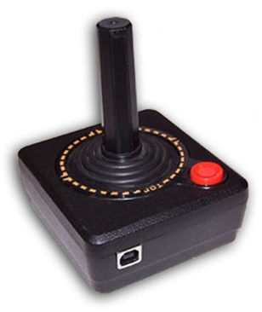
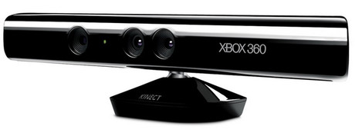
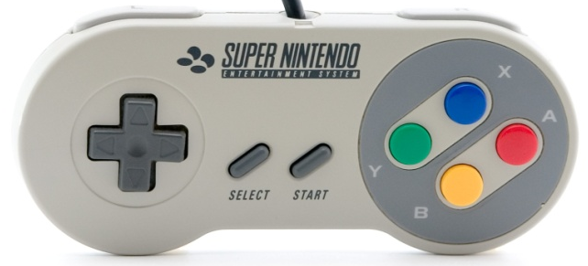
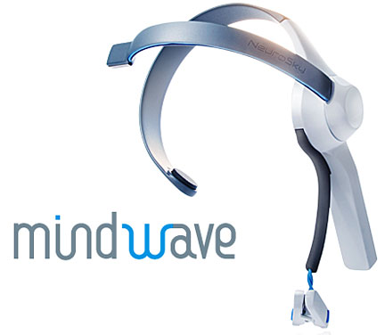
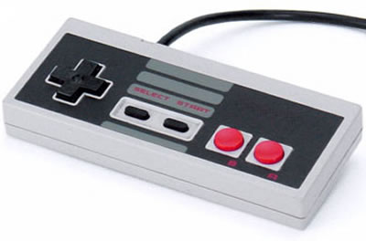
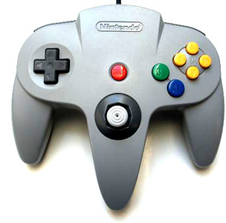
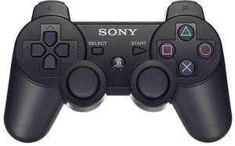
What we need to know from the activity…
1. Most technological development has been evolutionary, the result of a series of refinements to a basic invention.
?

Slide 17
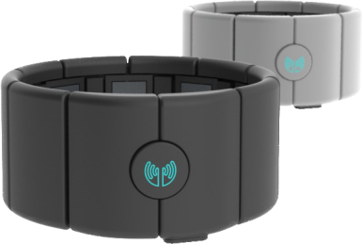
The Future of Gaming Controllers
Control Video Games with You Mind
http://www.latimes.com/business/technology/la-fi-tn-mind-games-how-brain-waves-control-a-video-game-20130307,0,5050953.story
See Also Video Below on Webpage
Gizmodo Article
http://gizmodo.com/240760/project-epoc-lets-you-control-video-games-with-your-noggin
Mind Flex
http://mindflexgames.com/what_is_mindflex.php
http://en.wikipedia.org/wiki/Mindflex
PARA
Paralyzed Woman Controls Robotic Arm With Mind

Slide 18
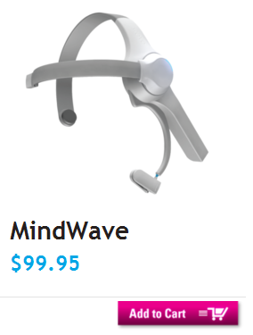
The Future of Education?
The MindWave Education turns your computer into a private tutor. The headset takes decades of laboratory brainwave technology and puts it into a bundled software package for under $100. It safely measures brainwave signals and monitors the attention levels of students as they interact with math, memory and pattern recognition applications. Ten apps are included with experiences ranging from fun entertainment to serious education.
- Lightweight
- Wireless
- Safe passive biosensors
- 8-hour AAA battery life
- Includes bonus CD with 10 neuroscience apps
- Supports Windows XP / Vista / 7
- Supports Mac OS X 10.5.8 and 10.6.x

Slide 19
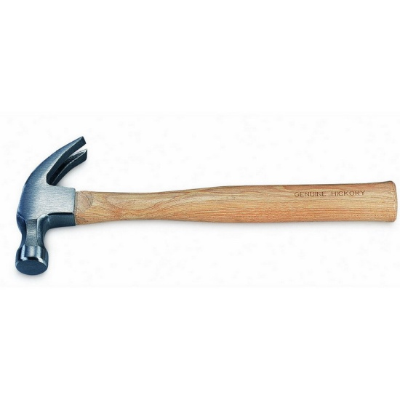
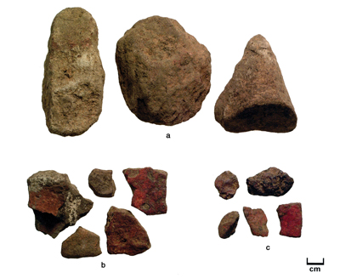
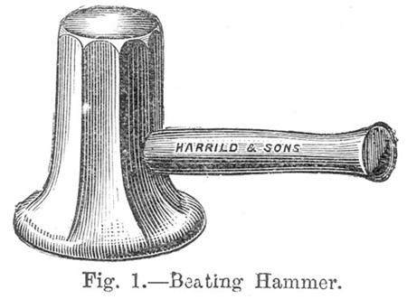
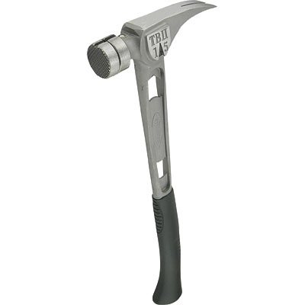
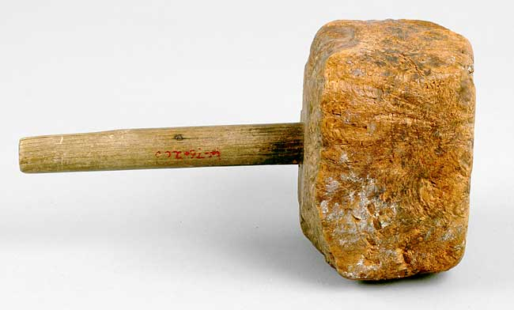
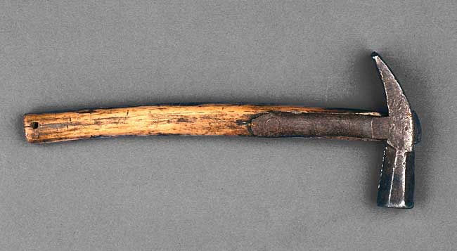
What we need to know from the activity…
2. The evolution of civilization has been directly affected by, and has in turn affected the development of tools and materials.

Slide 20
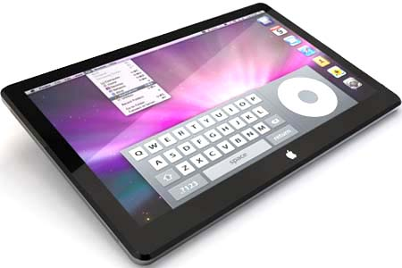
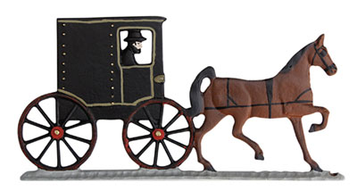
What we need to know from the activity…
3. Throughout history, technology has been a powerful force in reshaping the social, cultural, political, and economic landscape.

Slide 21
What we need to know from the activity…
Early in the history of technology, the development of many tools and machines was not based on scientific knowledge but on technological know-how.
Necessity is the mother of invention. Prov. When people really need to do something, they will figure out a way to do it.
Example: When the fan belt on Linda's car broke in the middle of the desert, Linda used her stockings as a replacement. Necessity is the mother of invention.

Slide 22
Chronological Periods
The study of history is defined by chronological periods.

Slide 23
Chronological Periods
The study of history is defined by chronological periods.
What period of time do we live in???

Slide 24
Chronological Periods
The study of history is defined by chronological periods.
What period of time do we live in???
HINT:

Slide 25
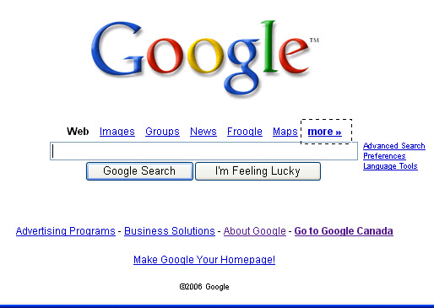
Chronological Periods
The study of history is defined by chronological periods.
What period of time do we live in???
Answer: The Information Age

Slide 26
What’s the connection between Technology & History???
Technology – is how humans modify the world around them to meet their needs and wants or to solve practical problems.

Slide 27
What’s the connection between Technology & History???
Technology – is how humans modify the world around them to meet their needs and wants or to solve practical problems.
More Simply,
Technology is human innovation in action!

Slide 28
What’s the connection between Technology & History???
Technology – is how humans modify the world around them to meet their needs and wants or to solve practical problems.
More Simply,
Technology is human innovation in action!
Technological Literacy is the ability to use, manage, and evaluate technology.

Slide 29
What’s the connection between Technology & History???
Technology – is how humans modify the world around them to meet their needs and wants or to solve practical problems.
More Simply,
Technology is human innovation in action!
Technological Literacy is the ability to use, manage, and evaluate technology.
*checkout the Rockwood’s Mission Statement!

Slide 30
What’s the connection between Technology & History???
Technology – is how humans modify the world around them to meet their needs and wants or to solve practical problems.
More Simply,
Technology is human innovation in action!
Technological Literacy is the ability to use, manage, and evaluate technology.
The use of technology affects humans’ comfort and safety… What??...

Slide 31
What’s the connection between Technology & History???
History– a chronological record of significant events, often including an explanation of their causes.

Slide 32
Periods of History
Periods of history are associated with:
technological evolution
major technological advancements
their impact on history

Slide 33
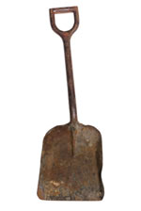
Technology’s Impact & Influence on Historical Ages Presentation Activity
Paleolithic Age
Mesolithic Age
Neolithic Age
Bronze Age
Iron Age
Middle Ages
Renaissance / Reformation / Enlightenment
Industrial Age
Information Age

Slide 34
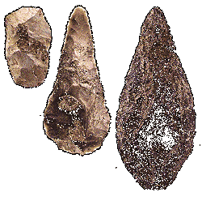
Paleolithic Age
Description:
earliest known stone tool manufacture
Artifacts:
stone axes, bone needles, hearth sites
Impact of technology on history:
Improved diet and enhanced security enabled early humans to increase their numbers.

Slide 35
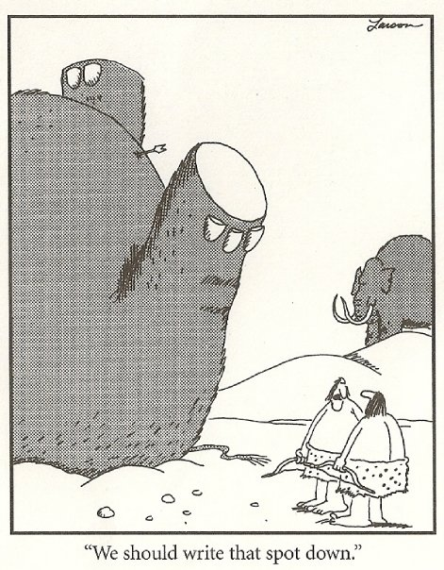
Paleolithic Age

Slide 36
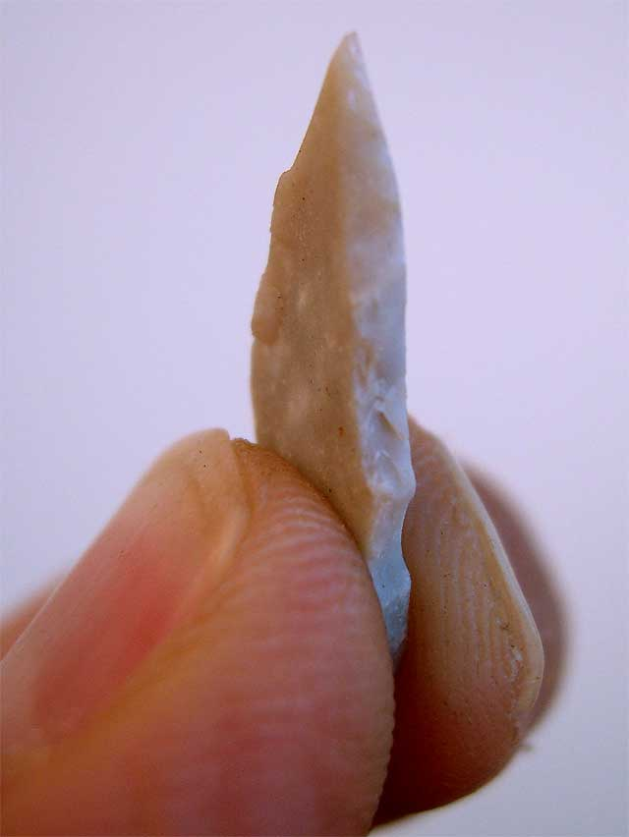
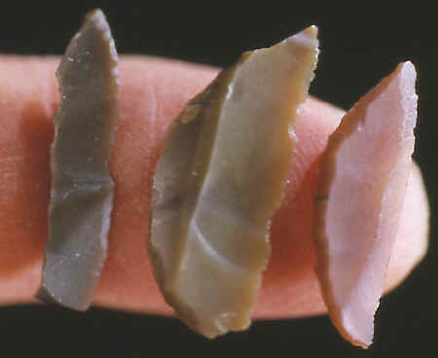
Mesolithic Age
Description:
Use of microliths (very small geometric-form tools commonly used in composite tools)

Slide 37
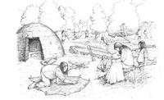
Mesolithic Age
Description:
Use of microliths (very small geometric-form tools commonly used in composite tools)
Artifacts:
leather work, basketry, fishing tackle, stone adzes and wooden objects such as canoes and bows, domesticating animals first began, stone circles, henges
Impact of Technology on History:
The gradual domestication of plants and animals led to the beginnings of settled communities.

Slide 38
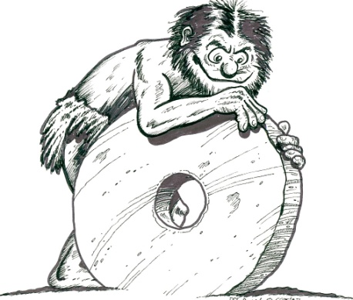
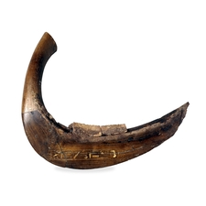
Neolithic Age
Description:
Development of agriculture and, hence, an increasing emphasis on year-round settlements.
Artifacts:
pottery, polished stone tools, spinning and weaving tools, wooden and stone plows, sickles, and the wheel
Impact of Technology on History:
Dependable year-round food
supply enables division of labor and
specialization that spurs invention
and innovation.

Slide 39
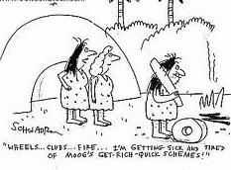
The “Stone Age”
The stone age is the generic term for the Paleolithic, Mesolithic, and the Neolithic Ages put together to create,
“The Stone Age”
“Wheels… clubs… fire… I’m sick ad tired of Moog’s
get-rich-quick schemes!”

Slide 40
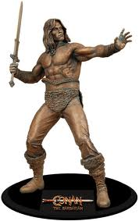
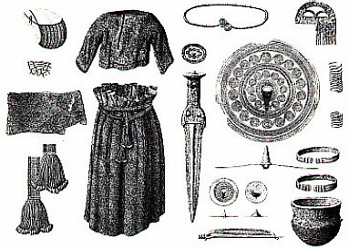
Bronze Age
Description
Earliest established civilizations
Development of metallurgy, mainly the combining of copper and tin to make bronze.
Artifacts
bronze jewelry, tools, and weapons
Impact of Technology on History
use of bronze was a great technological step and changed the course of everyday life as stone tools were gradually replaced by metal ones that enabled humans to alter their environment at a great rate

Slide 41
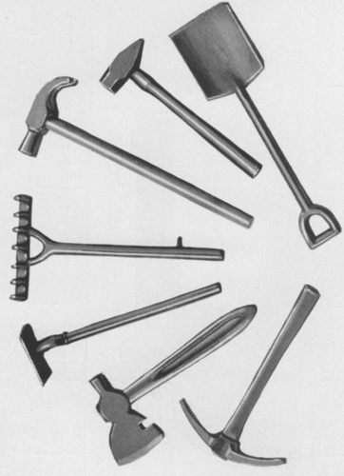
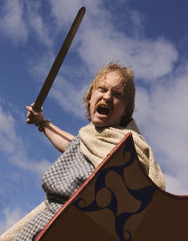
Iron Age
Description
use of iron as the main metal
Artifacts
iron dagger, iron chisels, small figurines, ornamental jewelry, swords, axes, spearheads
Impact of Technology on History:
Military dominance for uses of iron weapons and the use of iron-bladed plows enabled humans to cultivate heavier soils and increase food production.

Slide 42
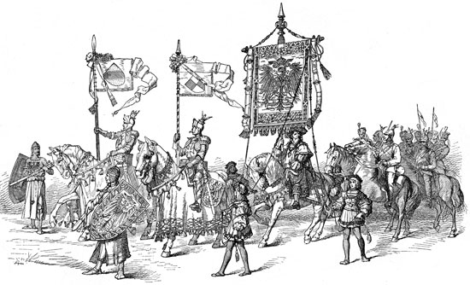
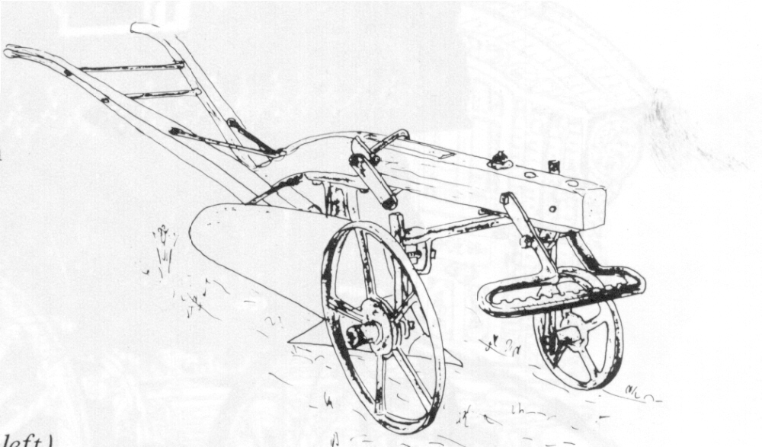
Middle Ages 450 – 1400
Description
European history between the fall of Rome and the Renaissance
Artifacts
wheeled plow, improved harness for horses, horseshoes, stirrups, water wheels, crank, windmill, cast iron, cannons, mechanical clock, compass, ocean-going ships
Impact of Technology on History
The rise and decline of serfdom and feudalism, the rise of the money economy and capitalism, the expansion and contraction of economic activity, and the beginnings of urbanization and industrialization.
BLACK DEATH

Slide 43
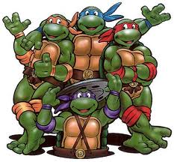
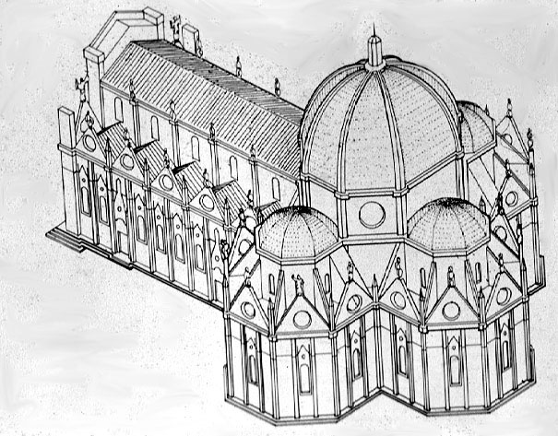
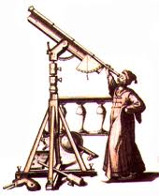
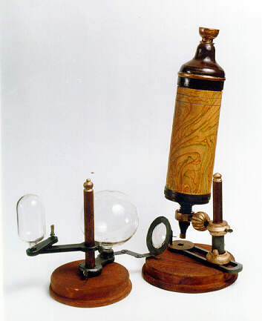
Renaissance/Reformation/Enlightenment 1400-1750
Description
The transitional movement in Europe between the Middle Ages and modern times, marked by a revival of classical influence
Artifacts
telescope, microscope, thermometer, clocks, barometer
Impact of Technology on History
Instrumentation enabled early scientists to
observe and quantify natural phenomena.
Renaissance Man

Slide 44
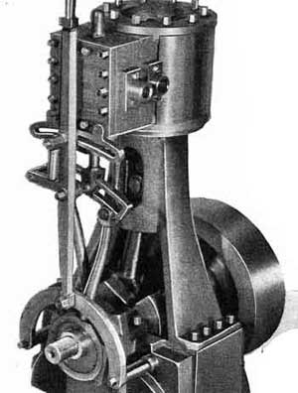
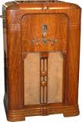
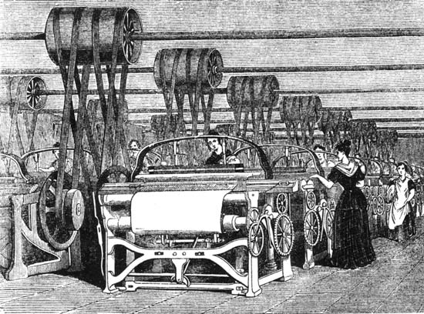
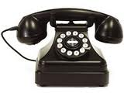
Industrial Age 1750-1950
Description
first use of complex machinery, factories, urbanization
economic and general social changes from strictly agricultural societies
Artifacts
steam engine, electricity, automobile, airplane, radio, television, telephone, and rocket
Impact of technology on history
rise to urban centers requiring vast municipal services,
provided the economic base for the rise of
the professions, population expansion
big improvement in living standards.

Slide 45
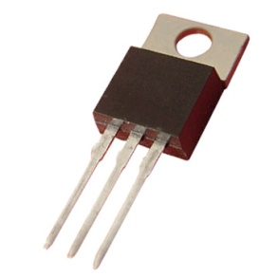
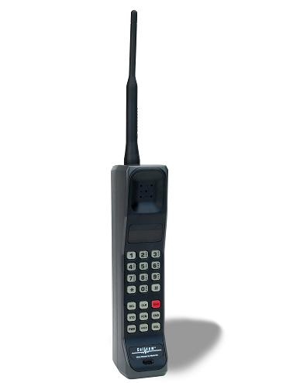
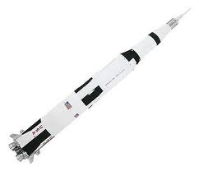
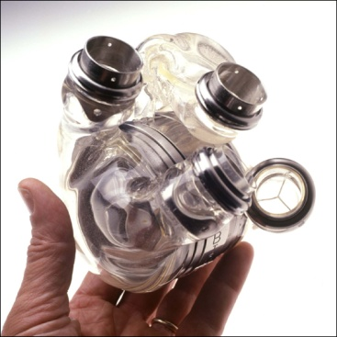
Information Age 1950-Present
Description:
gathering, manipulation, classification, storage, and retrieval of information is central to the workings of society
Artifacts:
transistor, integrated circuit, computer, communication satellite, digital photography, artificial heart, nuclear power plant, space shuttle, Internet, smart phone
Impact of technology on History:
people can make more informed decisions that “experts” now make
empowering more people
Free flow of information & knowledge
Technology at our fingertips

Slide 46
ACTIVITY: THE CUTTING EDGE of TECHNOLOGY
DIRECTIONS: Select one of the articles and respond to it with a PSSA style response.
Read the ENTIRE article.
You will write two paragraphs. One complete paragraph for each question
Explain how the technological advancement will impact your future life? (or a relative / friend)
2. Explain how the technological advancement will influence or change the world around you?

Slide 47
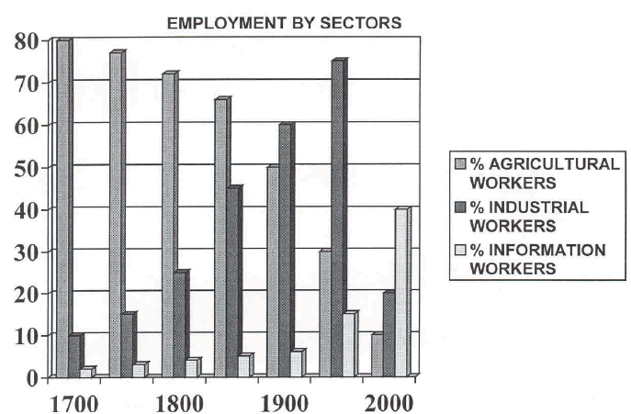
ACTIVITY Handout: Historical Analysis of Employment by Sectors

Slide 48
More INFO to KNOW for the TEST
Compare and contrast the amount of physical labor and knowledge required of people in each time period.

Slide 49
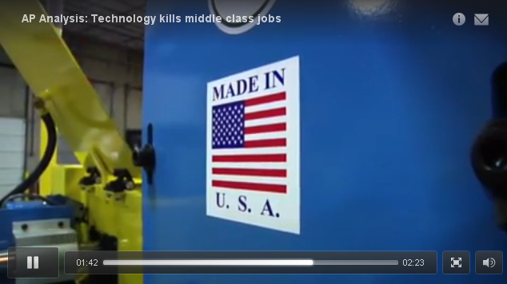
More INFO to KNOW for the TEST
Compare and contrast the amount of physical labor and knowledge required of people in each time period.
Bottom line:
Over time, the required physical labor has declined however the knowledge required has increased.
Technology Kills Middle Class Jobs
Meet Baxter - Video

Slide 50
More INFO to KNOW for the TEST
Over time, the required physical labor has declined however the knowledge required has increased.
Modern science is based on traditions of thought that came together in Europe about 500 years ago.

Slide 51
More INFO to KNOW for the TEST
Over time, the required physical labor has declined however the knowledge required has increased.
Modern science is based on traditions of thought that came together in Europe about 500 years ago.
Example: Scientific Method
Can you remember some of the steps of the scientific method?

Slide 52
More INFO to KNOW for the TEST
Over time, the required physical labor has declined however the knowledge required has increased.
Modern science is based on traditions of thought that came together in Europe about 500 years ago.
Example: Scientific Method
Define the question
Gather information and resources (observe)
Form hypothesis
Perform experiment and collect data
Analyze data
Interpret data and draw conclusions that serve as a starting point for new hypothesis
Publish results
Retest (frequently done by other scientists)

Slide 53
More INFO to KNOW for the TEST
Over time, the required physical labor has declined however the knowledge required has increased.
Modern science is based on traditions of thought that came together in Europe about 500 years ago.
Scientific Method – used for developing hypothesis, observing phenomena (things / stuff that happens), acquiring knowledge, and solving problems.
In engineering and in design, we use “THE DESIGN PROCESS”
-see poster
-compare / contrast to the Scientific Method

Slide 54
Design Brief PAPER TABLE
Do you think that you can build a table out of 8 sheets newspaper and some masking tape to support the Grainger Catalog?

Slide 55
Industrial Revolution
The Industrial Revolution happened first in Great Britain
practical use of science
had access by sea to world resources and markets
had an excess of farm workers willing to become factory workers.

Slide 56
Industrial Revolution
The Industrial Revolution happened first in Great Britain
practical use of science
had access by sea to world resources and markets
had an excess of farm workers willing to become factory workers.
increased the productivity of each worker, but it also increased child labor and unhealthy working conditions

Slide 57
Industrial Revolution
The Industrial Revolution happened first in Great Britain
practical use of science
had access by sea to world resources and markets
had an excess of farm workers willing to become factory workers.
increased the productivity of each worker, but it also increased child labor and unhealthy working conditions
it gradually destroyed the craft tradition.

Slide 58
Industrial Revolution
The Industrial Revolution happened first in Great Britain
practical use of science
had access by sea to world resources and markets
had an excess of farm workers willing to become factory workers.
increased the productivity of each worker, but it also increased child labor and unhealthy working conditions
it gradually destroyed the craft tradition.
The Industrial Revolution is still underway as electric, electronic, and computer technologies emerge in other countries China & India

Slide 59
Industrial Revolution
The Industrial Revolution happened first in Great Britain
practical use of science
had access by sea to world resources and markets
had an excess of farm workers willing to become factory workers.
increased the productivity of each worker, but it also increased child labor and unhealthy working conditions
it gradually destroyed the craft tradition.
The Industrial Revolution is still underway as electric, electronic, and computer technologies emerge in other countries
changed patterns of work and brought economic and social consequences

Slide 60
ACTIVITY: PROS and CONS of Technological Impacts
“The value of any given technology may be different for different groups of people and at different points in time.”
SOCIAL
CULTURAL
AUTOMOBILE
ECONOMIC
POLITICAL

