Slide 1
Mice, Moles, Voles
Mrs. Weimer

Slide 2
Background Information
Prolific Breeders
At the base of the food chain
Rodentia Family
Indicated by two pair of constantly growing teeth
Hoarders of food stuffs
Live in nearly every habitat
Most feed at night and remain active year round

Slide 3
Gestation Period = 3 Weeks
Young are born without fur and eyes are closed
Mother nurses them, but within a month they are weaned and can reproduce themselves during their first year
Meadow Vole can give birth to 9 litters and an average of 72 babies per year

Slide 4
MICE & VOLES
Small creatures
Base of food chain
Prefer vegetation, will eat eggs, insects, snails, etc.
Feed at night, active yr. round
Deer Mouse

Slide 6
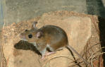
Deer Mouse

Slide 7
Deer Mouse
2 forms:
Woodland deer mouse
Prairie Deer Mouse
Omnivores
Have sharp hearing and eyesight
Can swim
Run at 5 miles per hour
Tail used for steadiness
Breed from March to October
3-4 litters per year, 3-7 young per litter

Slide 8
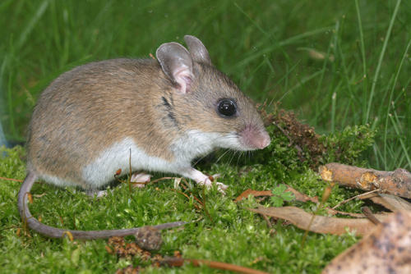
White footed mouse
Most abundant RODENT in PA
Prefers drier habitat than deer mouse
Eat about 1/3 of their body weight daily
Breed March-October
Males sometimes help females with young

Slide 9
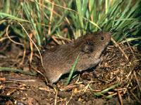
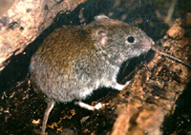
Red Backed Vole
Meadow Vole

Slide 11
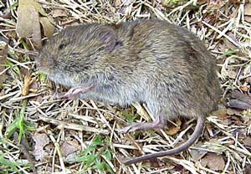
Meadow Vole

Slide 12
Meadow Vole
6-7 inches long, so much bigger than mouse
Thrive in moist environments and field with sedges
do not live in the forest
Good swimmers and can run at five mph
Use a network of pathways in the field
Eat grass and sedges, tubers, root grains, and can girdle small trees
Up to 160 voles can live per acre
Average litter is 4-6 with 5-7 litters per year

Slide 13
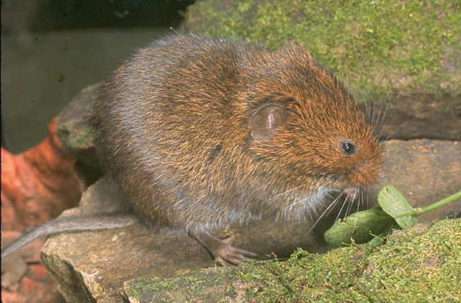
Rock Vole
Limited to north east PA
Inhabits forests
Yellowish nose
Considered rare in PA

Slide 14
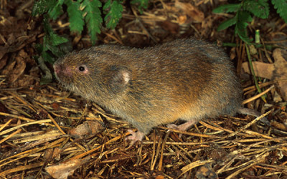
Woodland Vole
Throughout PA
PA’s smallest vole at 4-5 inches long
Woodland bottomlands, forests, old fields
Burrows beneath the soil
Seldom leaving the burrow
Cache of food
Breed less prolifically than other voles
1-4 litters per year with 1-5 voles per litter

Slide 15
WOODRAT “pack rat”
Lives in remote, rocky habitats
Grayish-brown coat above, white below
Round ears, long whiskers, bulging eyes
Stockpile food & “treasures” (skulls, feathers, bottle caps, coins, rags, etc.)

Slide 17
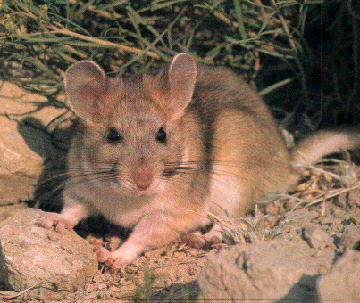

Slide 18
Woodland rat is AKA the Norway Rat
12-18 inches long
Arrived from Europe aboard ships around 1775
Have poor vision, but other sense well developed
Mainly nocturnal
Can eat anything
They kill poultry, snakes, rats from other colonies, birds
Breed throughout the year
6-8 litters per year 6-9 per litter

Slide 19
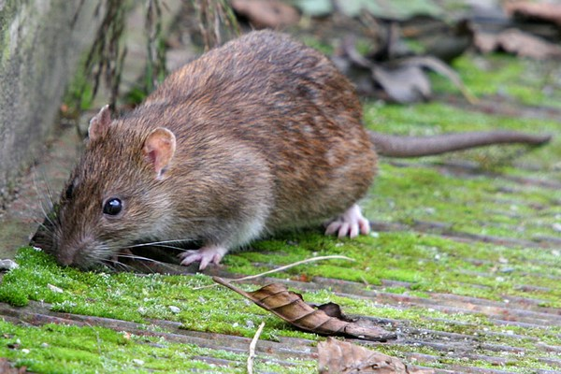
Carry many diseases
Rabies
Tularemia
Typhus
Bubonic plague

Slide 20
Bubonic Plague

Slide 21
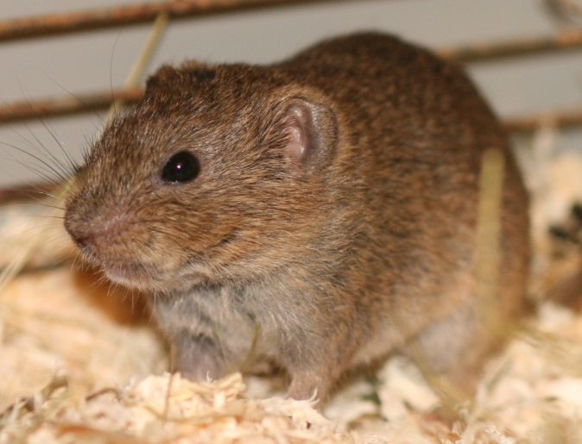
Southern Bog Lemmings
Looks like the meadow vole
Scattered throughout PA
Live beneath dead grasses and create runways above the ground
Often share (cohabitate) with moles, voles, mice

Slide 22
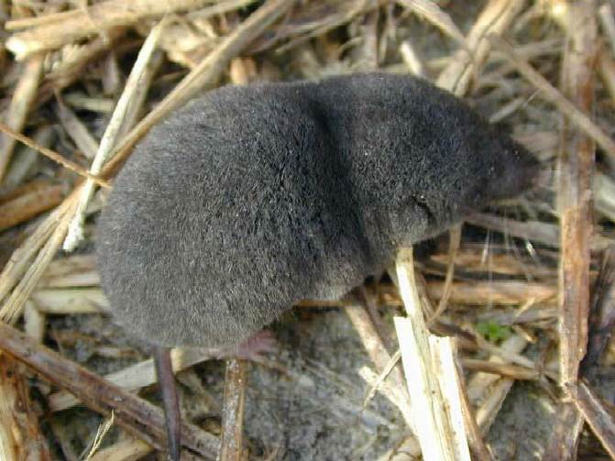
SHREW
Food: mainly insects (“Insectivore”)
Usually less than 5”
Light brown or gray coat
Look like mice BUT – shrews have 5 toes/foot and mice have 4 toes/foot (front)
Sharp, pointed dark stained teeth
Beadier eyes and pointier noses than mice
One species has poisonous saliva
Many species in PA - hard to tell apart
Very rapid metabolism (1,200 beats/min.) so starve to death easily

Slide 25
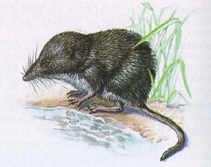

Slide 27
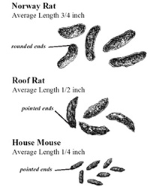

Slide 28
