Slide 1
Objectives:
Verbally explain the principal of how a battery works (Comprehend)
Demonstrate the basic principles of a wet cell battery (Apply)
Compare and contrast the similarities and differences between a wet and dry cell (Analyze)
Research a specific type of battery (Analyze)
Appraise the qualities of various types of batteries and select a battery type for the Bots IQ entry (Evaluate)

Slide 2
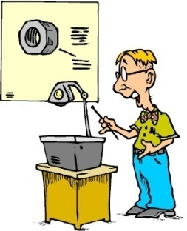
Identify a Challenge
Present the Solution
Explore Ideas
Engineering
Design
Process
Test & Evaluate
Plan & Develop

Slide 3
Batteries
All Charged Up.

Slide 4
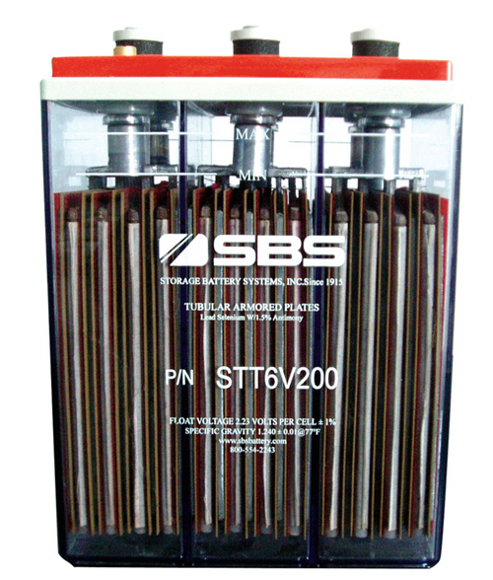
What is a Battery?
electrochemical battery - or, more precisely, a "cell" - is a device in which the reaction between two substances can be made to occur in such a way that some of the chemical energy is converted to useful electricity.

Slide 5
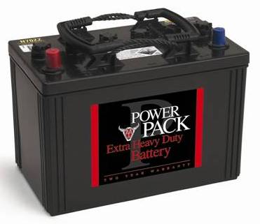
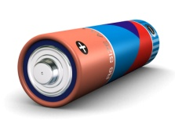
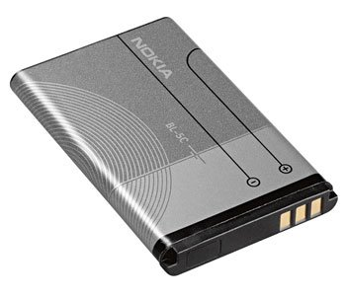
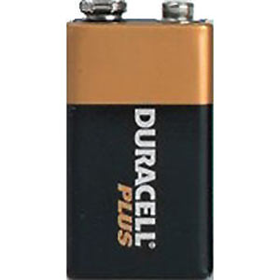
2 Major types of batteries
Wet Cell Dry Cell
A wet cell is a galvanic electrochemical cell with a liquid electrolyte.
A dry cell is a galvanic electrochemical cell with a pasty low moisture electrolyte.

Slide 6
HOW Does a wet cell battery Work?
The "cathode" or "positive" electrode, which consists of a mass of "electron-receptive" chemical held in intimate contact with a metallic "plate“.
+ POSITIVE
Zinc Coated Nail

Slide 7
HOW Does a wet cell battery Work?
The "anode" or "negative" electrode, which consists of another chemical which readily gives up electrons - an "electron donor"
- Negative
1¢
Copper Penny
FYI: (If your penny has a date before 1982, it is made of 95% copper. If the date is 1983 or later, it is made of 97.5% zinc and plated with a thin copper coating.)

Slide 8
HOW Does a wet cell battery Work?
The "electrolyte," usually a liquid solution that permits the transfer of mass necessary to the overall reaction.
Lemon
FYI: (Potatoes, apples, or any other fruit or vegetable containing acid or other electrolyte can be used, but lemons are preferred because of their higher acidity.)

Slide 9
HOW Does a wet cell battery Work?
The copper coin serves as the positive electrode or cathode and the galvanized nail as the negative electrode or anode. These two objects work as electrodes, causing an electrochemical reaction which generates a small potential difference.
-
+
Cathode
Anode
+ + + +
+ + +
+ +
+
-- -- -- --
-- -- --
-- --
--
Electrolyte with High Acidity

Slide 10
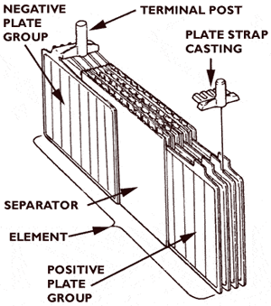
A car battery works the same way
Lead-acid batteries are made up of plates of lead and separate plates of lead oxide, which are submerged into an electrolyte solution of about 35% sulfuric acid and 65% water. This causes a chemical reaction that releases electrons, allowing them to flow through conductors to produce electricity.

Slide 11
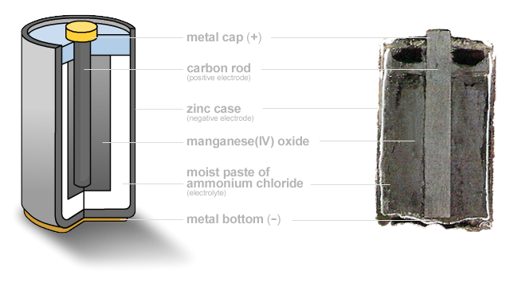
HOW DOES A DRY CELL BATTERY WORK?

Slide 12
What is a Battery “life cycle”?

Slide 13
What is a Battery “life cycle”?
Battery cycle life is defined as the number of complete charge - discharge cycles a battery can perform before its nominal capacity falls below 80% of its initial rated capacity.
Lifetimes of 500 to 1200 cycles are typical.

Slide 14
What is a battery “memory”?

Slide 15
What is a battery “memory”?
"Memory effect" is now used as a general term for anything that makes a battery not deliver its full capacity.
FACT or MYTH?
URBAN LEGENDS

Slide 16
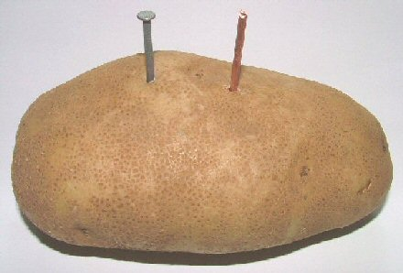
Now it’s your turn!

Slide 17
Just for fun
6 Volt Battery Hack
Insane Car Battery Hack

Slide 18
WORKS CITED
AANT. (2007). Benefits of Membership. Retrieved Januray 27, 2009, from AANT: http://www.aant.com.au/Membership/BenefitsofMembership/tabid/62/Default.aspx
Biz/Ed. (2006, September 25). Batteries Included. Retrieved January 27, 2009, from Biz/Ed: http://www.bized.co.uk/current/leisure/2006_7/250906.htm
Boyd, E. (2008, April 18). Batteries: Power, Energy, and Units. Retrieved January 27, 2009, from X Prize Cars:
http://xprizecars.com/2008/04/batteries-power-energy-and-uni.php
Daneboe. (2007, September 17). 6 Volt Battery Hack. Retrieved January 27, 2009, from YouTube: http://www.youtube.com/watch?v=nzgDffMcsUU
Daneboe. (2007, December 11). Insane Car Battery Hack. Retrieved January 27, 2009, from YouTube: http://www.youtube.com/watch?v=s_8n2Qgguto
Farm 3 Static. (2009). Retrieved January 27, 2009, from Flickr: http://farm3.static.flickr.com/2023/2278454056_c63956c9a7.jpg?v=0
GERMES LLC. (2005). Rechargable Batteries. Retrieved January 27, 2009, from GERMES:
http://www.germes-online.com/catalog/87/90/444/rechargeable_batteries.html
GERMES. (2005). Rechargable Battery Packs. Retrieved January 27, 2007, from Germes Online:
http://www.germes-online.com/catalog/87/90/449/page6/269287/rechargable_battery_packs.html
LST LLC. (2008). Get Better Battery Life in Five Minutes. Retrieved January 27, 2008, from All Shadow . Com:
http://www.allshadow.com/2008/07/21/get-better-battery-life-in-5-minutes/
Mobile Geeks. (2008, November 12). How to Save Your Mobile Phone's Battery Life While You Sleep. Retrieved January 12, 2009, from Mobile Geeks:
http://www.mobile-geeks.com/how-to-save-your-mobile-phones-battery-life-while-you-sleep/153/

Slide 19
Works Cited
Northern Tool + Equipment Catalog Co. (2009). Makita Nickel Metal Hydride Rechargeable Battery — 18 Volt . Retrieved January 27, 2009, from
Northern Tool + Equipment: http://www2.northerntool.com/power-tools/power-tool-accessories/item-1591773.htm
Science Projecsts Resources.com. (2008). How to Make a Potato Battery. Retrieved January 27, 2009, from Science Project Resources:
http://www.science-projects-resources.com/how-to-make-a-potato-battery.html
Second Chance Garage, LLC. (2009). Automotive Electrical Systems - Part 1. Retrieved January 27, 2009, from Second Chance Garage:
http://www.secondchancegarage.com/public/98.cfm
Storage Battery Systems Inc. (2006). Flooded Batteries. Retrieved January 27, 2009, from Storage Battery Systems:
http://www.sbsbattery.com/subpage_index.php?_subp_=93
Wikimedia Foundation Inc. (2009, January 8). Dry Cell. Retrieved January 27, 2009, from Wikipedia: http://en.wikipedia.org/wiki/Dry_cell
Wikimedia Foundation Inc. (2009, January 24). Rechargable Battery. Retrieved Januray 27, 2009, from Wikipedia:
http://en.wikipedia.org/wiki/Rechargable_batteries
Wikimedia Foundation Inc. (2009, January 10). Wet Cell. Retrieved January 27, 2009, from Wikipedia: http://en.wikipedia.org/wiki/Wet_cell

